Slide 1
Roadside Parking Solution
By
Harshada Kumbhare
Umesh Sharnagat

Slide 2
Purpose of project
Counting the number of parked cars.
Identifying the available location for car parking.

Slide 3
Assumptions
A circle of white colour is drawn at all parking slots.
The system detects empty slots through images at any angle unless the circle becomes a line.
The camera can be easily moved to detect different car parking lots.

Slide 4
Preprocessing
Conversion of colour to Grayscale
Adaptive thresholding
Opening Operation
Code
T = adaptthresh(I, 0.4);
BW = imbinarize(I,T);
se = strel('square’,3);
I = imopen(I,se);
Notes:
T = adaptthresh(I) chooses the threshold based on the local mean intensity (first-order statistics) in the neighborhood of each pixel.

Slide 5
Case 1 : Top view
Parameters needed to find circles
Maximum number of expected circles (parking slots) in the image.
Minimum and maximum radius of circles.
Code
[centers, radii] = imfindcircles(ImageName,[lower_cutoff_radius higher_cutoff_radius],'ObjectPolarity','bright','Sensitivity',
sensitivity);

Slide 6
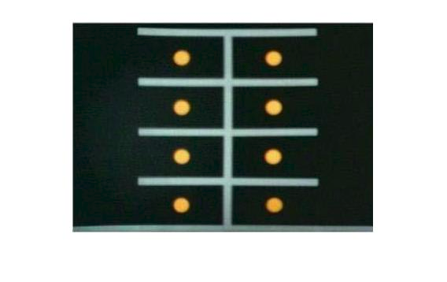
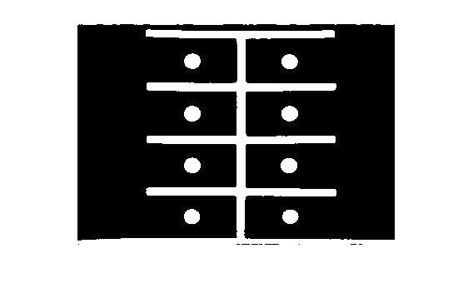
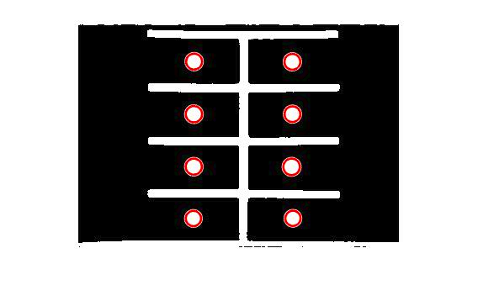
Results on image 1
Threshold Image
Original Image
FInal Result

Slide 7
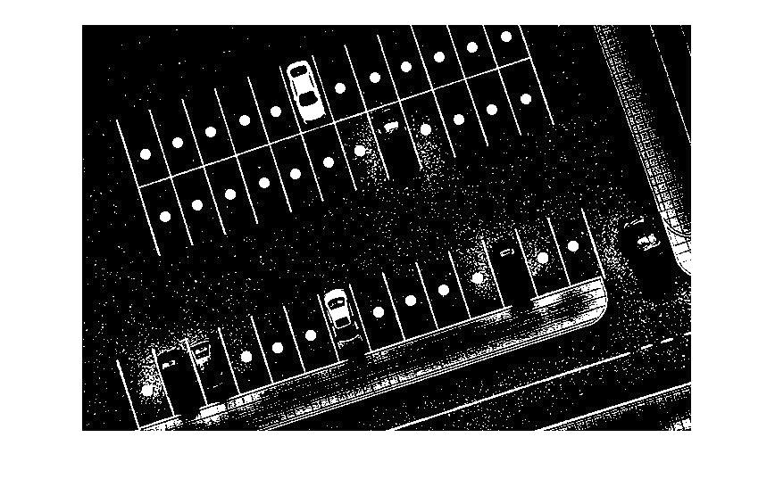
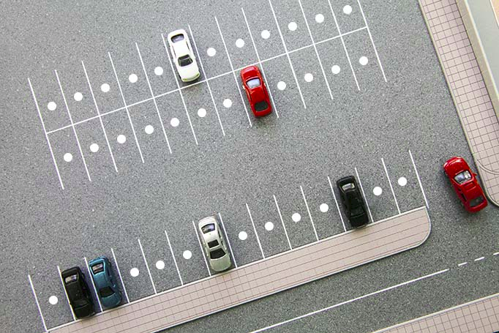
Results on image 2
Original Image
Threshold Image

Slide 8
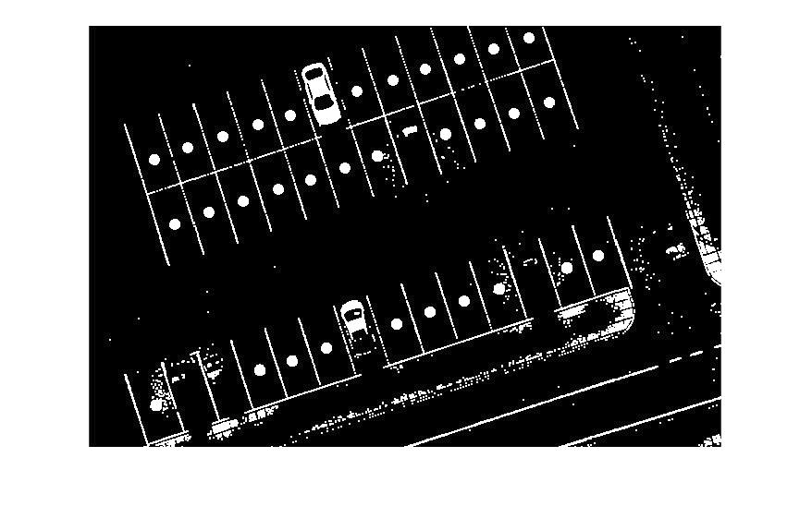
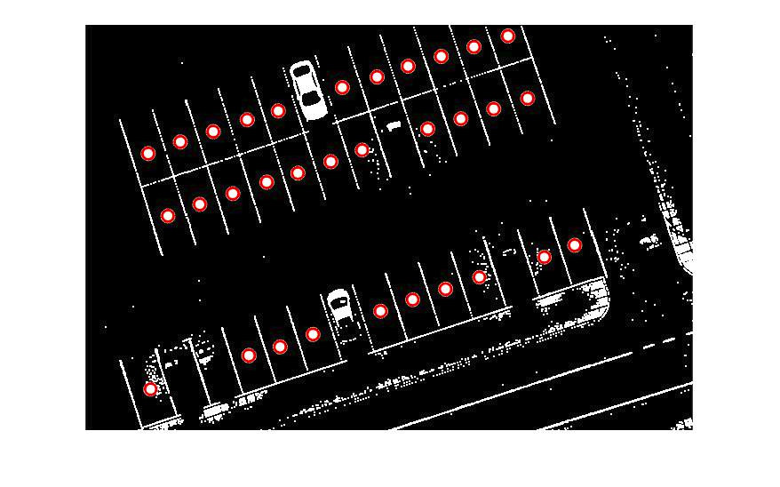
Results on Image 2
Image after Opening Operation
Available parking slots

Slide 9
Case 2 : At any angle of camera
Input:
Coordinates of each parking slot.
Processing:
Colour to grayscale, adaptive thresholding, opening operation
Finding connected components
Testing whether the connected component is ellipse at given input positions of parking slots using hough transform.
Parameters:
minMajorAxis and maxMajorAxis
rotation, rotationSpan
minAspectRatio
Randomize and numBest
Notes:
It will always form a ellipse of a>b and perfectly on the x and y axis

Slide 10
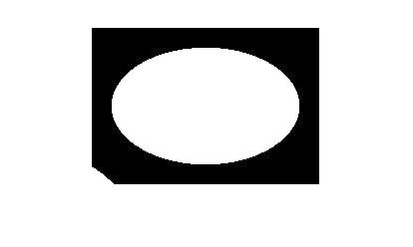
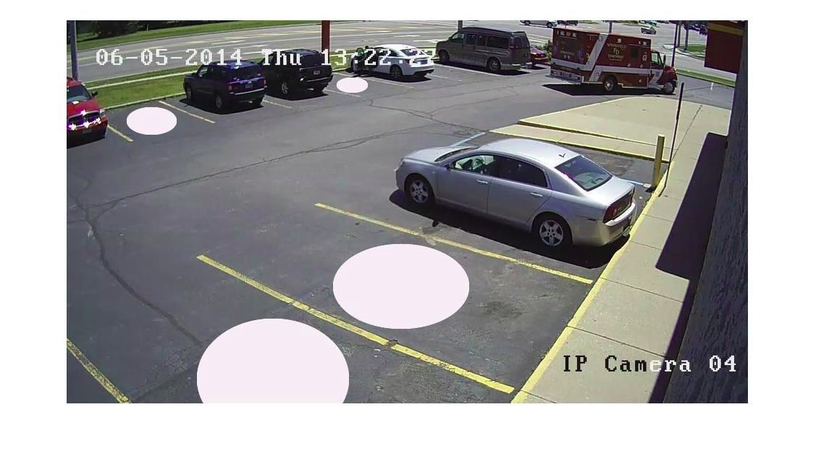

Results on image 3
Extracted Components
Original image

Slide 11
Problems faced
Hough Transform
It detects false ellipse in the background
It detects same ellipse more than once.
Only parking slots completely present in the image can be detected.

Slide 12
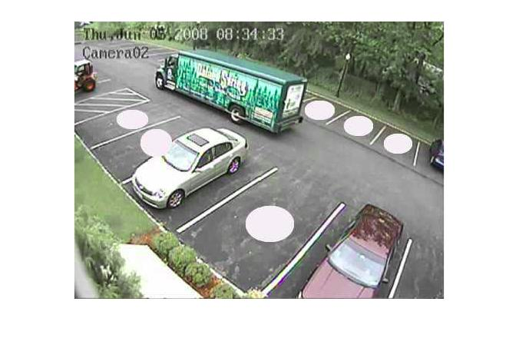
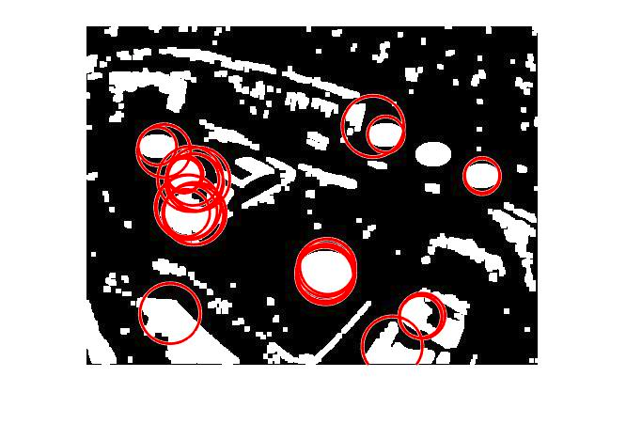
Example for previous slide

Slide 13
Another approach
Detect empty parking slots with rectangular boundaries.
In this approach, we compared image taken before and after parking of cars.
We tried to find out slots in background image(having no cars), then we did image subtraction to find out possible position of cars followed by morphological processing to increase accuracy.

Slide 14
Background Image
(without cars)
Morphological processing
Like smoothing, Increasing quality of slot borders etc.
Finding out slots of specific area and binarize it
Image frame containing only slots
Frame/ basis/mask for further processing
Extracted slot image frame
Frame mask generation

Slide 15
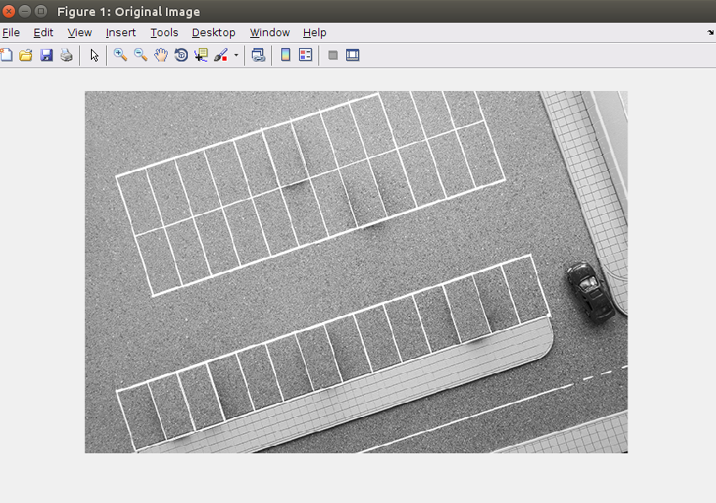
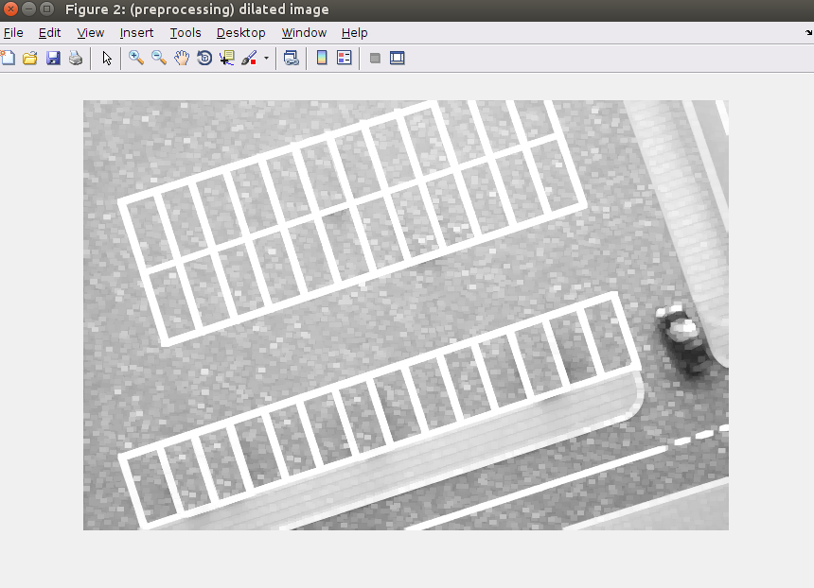
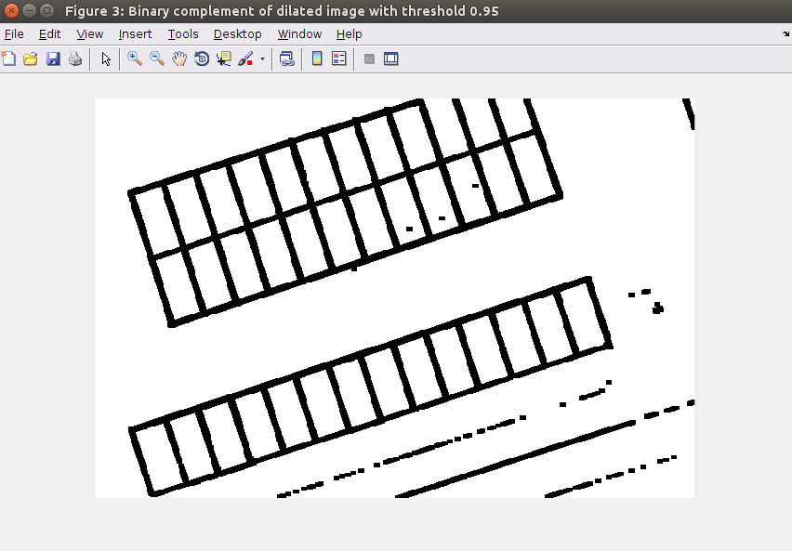
Preprocessing
Dilation two times
Binary image with threshold of 0.95.
Complement image

Slide 16
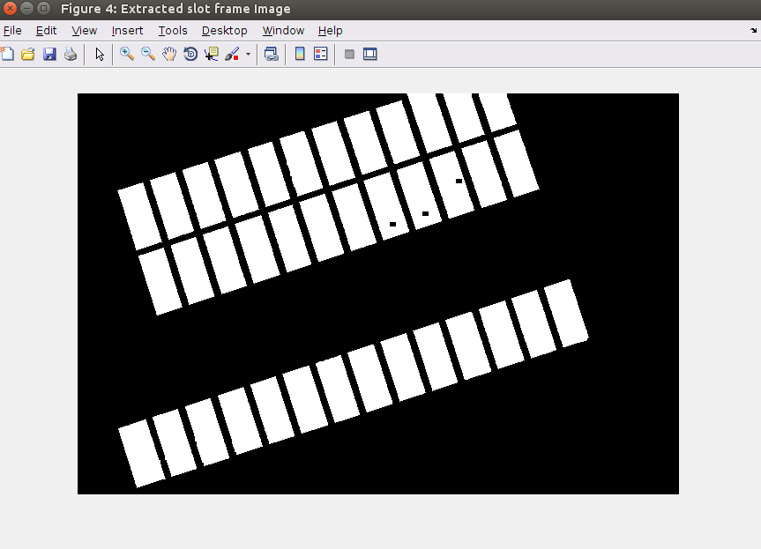
Parking slot extraction using connected component area
cc = bwconncomp(bImage);
numPixels=cellfun(@numel,cc.PixelIdxList);
m2=size(numPixels,2)
for idx=1:m2
if numPixels(idx)>1200 &&
numPixels(idx)<3000
bImage(cc.PixelIdxList{idx})=1;
else
bImage(cc.PixelIdxList{idx})=0;
end
end

Slide 17
Background image .* slot frame
-
Instant image * slot frame
(with some cars parked)
= Difference Image
Morphological processing
Like gradient, dilation, etc. to enhance cars that are found in image
complement image to show free slots instead of occupied slots
Final output with count of free slots
Algorithm

Slide 18
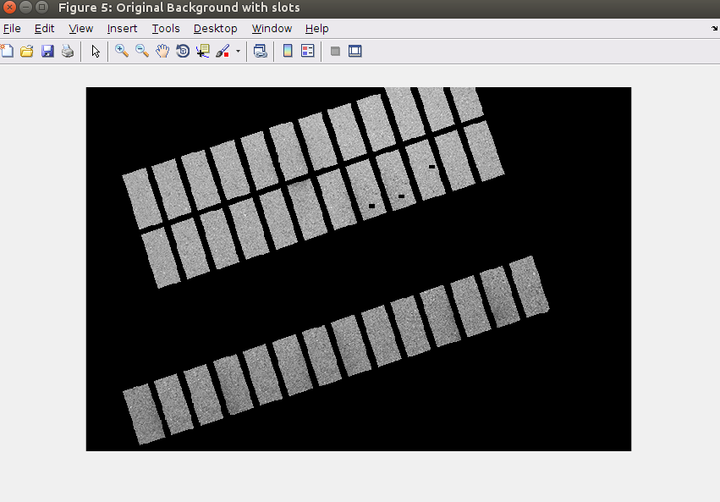
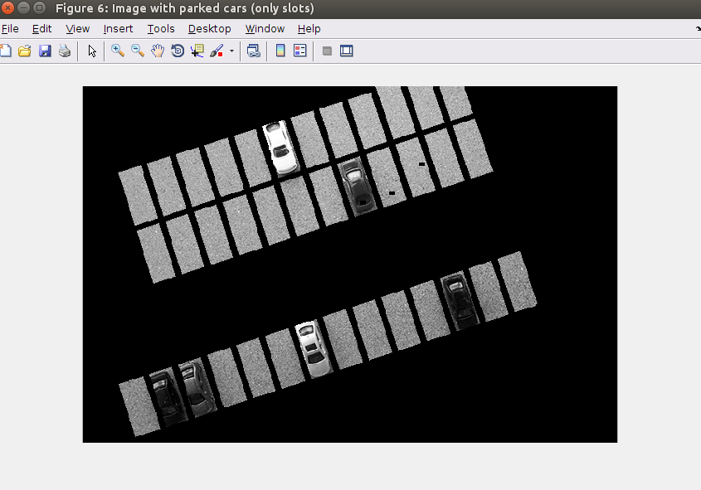
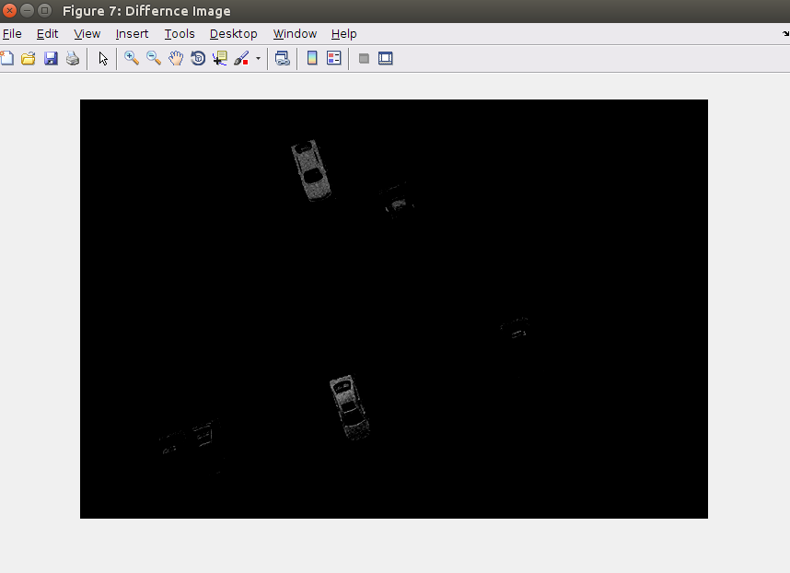
DIfference Image obtained after subtracting two images

Slide 19
Difference Image

Slide 20
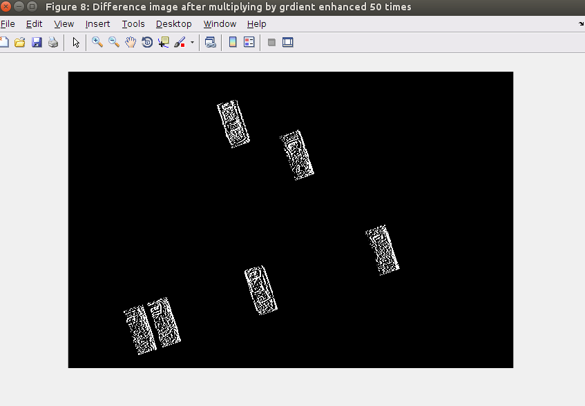
Difference Image enhanced by adding its gradient 50 times.

Slide 21
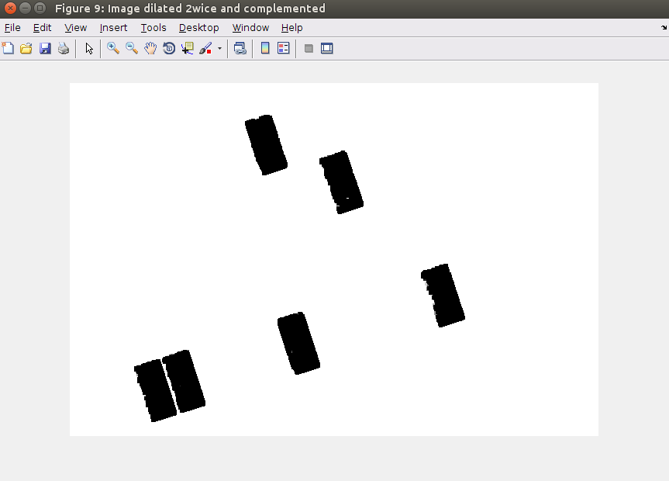
Dilate detected cars twice to fill holes and then complement

Slide 22
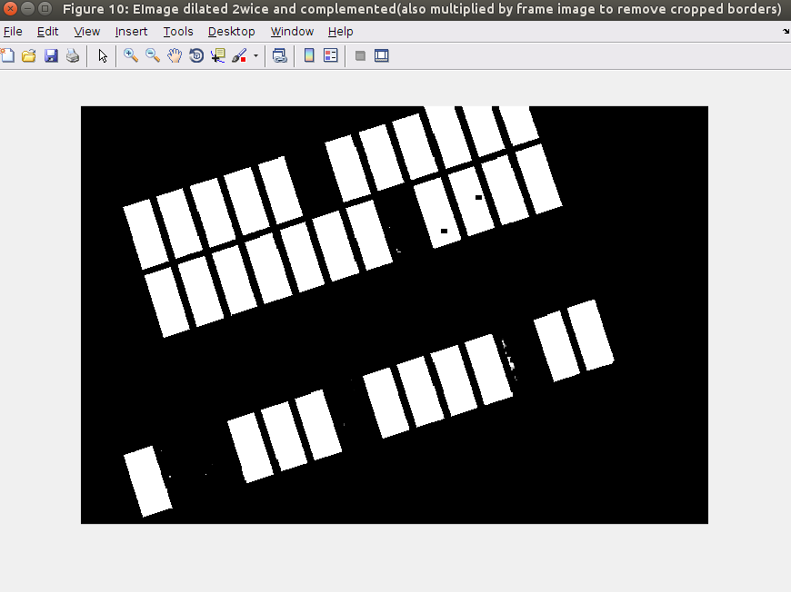
Multiply above image by slot image to extract ROI

Slide 23
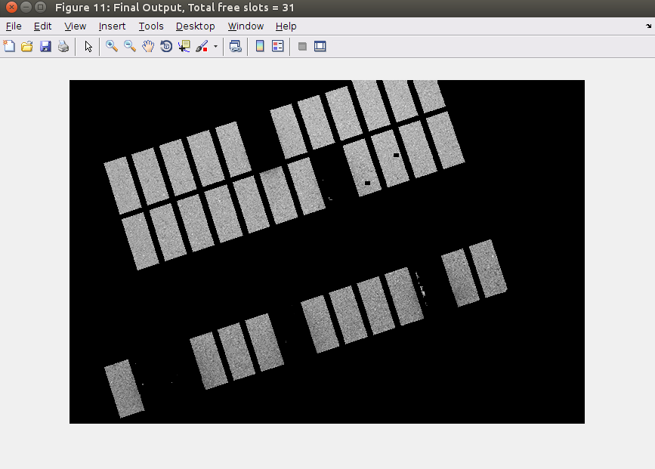
Final Output

Slide 24
THANK YOU

